Slide 1
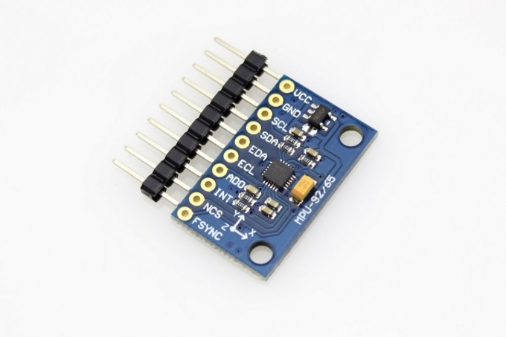
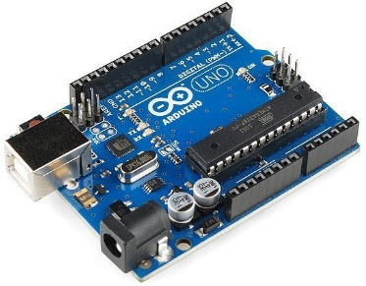
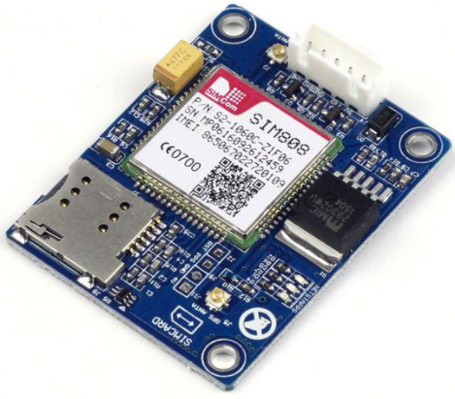
Storage (Memory)
I2C
UART
Module SIM808
3-axis ADXL345 accelerometer
MCU PIC18F4520
Rechargeable Battery
3.7V - 6000mAh

Slide 2
Phase 1: Data Acquisition
Our proposed device
Get acceleration data
Activities Features Extraction/Selection
Windowing
Phase 2: Features Analysis
Training and Classification
Activities
Phase 3: Activities Recognition

